Slide 1
20XC32 Microcontrollers and Embedded programming

Slide 2
TIME DELAY

Slide 3
TIME DELAY
There are two way s to create a time delay in 8051 C
Using the 8051 timer
Using a simple for loop
Three factors that can affect the accuracy of the delay
1. The 8051 design
The number of machine cycle
The number of clock periods per machine cycle
2.The crystal frequency connected to the X1 – X2 input pins
3. Compiler choice
C compiler converts the C statements and functions to Assembly language instructions
Different compilers produce different code

Slide 4
TIME DELAY (contd)
Write an 8051 C program to toggle bits of P1 continuously forever with some delay.
//Toggle P1 forever with some delay in between //“on” and “off”
#include <reg51.h>
void main(void)
{ unsigned int x;
for (;;) //repeat forever
{ p1=0x55;
for (x=0;x<40000;x++); //delay size unknown
p1=0xAA;
for (x=0;x<40000;x++);
} }

Slide 5
How to introduce time delay???

Slide 6
Time delay calculation
Clock and communication requirement
Instruction cycle=1/2/4 …Machine cycles
1 machine cycle = 12 clock pulses

Slide 7
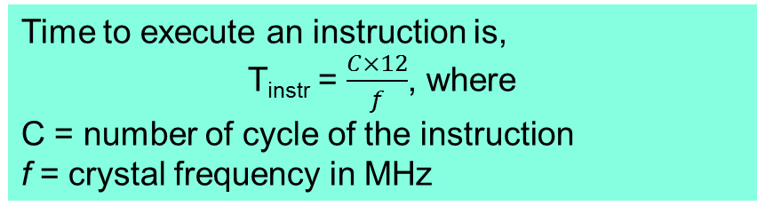
Time Delay Calculations for 8051 Microcontroller
The 8051 microcontroller works with 11.0592 MHz frequency.
Frequency f _{osc}= 11.0592MHz
1 clock pulse period =1/11.0592MHz = 0.090422 x 10⁻⁶ sec
(1 Machine cycle = 12 pulses )
Time delay for 1 machine cycle T= 0.090422 x 10⁻⁶ sec x 12
T=1.08506 µs (for ‘1’ cycle)

Slide 8
TIME DELAY (contd)
Write an 8051 C program to toggle bits of P1 continuously forever with some delay.
//Toggle P1 forever with some delay in between //“on” and “off”
#include <reg51.h>
void main(void)
{ unsigned int x;
for (;;) //repeat forever
{ p1=0x55;
for (x=0;x<40000;x++); //delay size unknown
p1=0xAA;
for (x=0;x<40000;x++);
} }

Slide 9
TIME DELAY (contd)
Write an 8051 C program to toggle bits of P1 ports continuously with 250 ms.
#include <reg51.h>
void MSDelay(unsigned int);
void main(void)
{ while (1) //repeat forever
{ p1=0x55;
MSDelay(250);
p1=0xAA;
MSDelay(250);
}
}
void MSDelay(unsigned int itime)
{
unsigned int i,j;
for (i=0;i<itime;i++)
for (j=0;j<1000;j++);
}

Slide 10
IO Programming

Slide 11
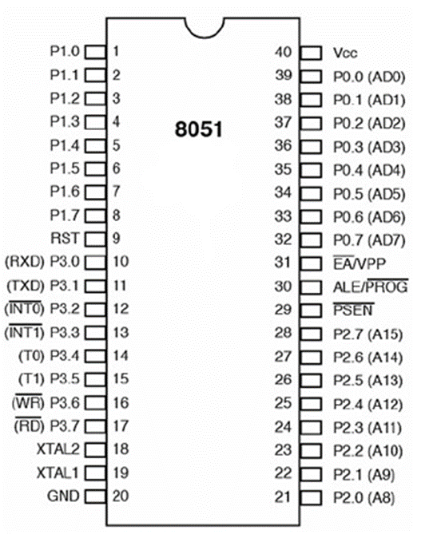
IO Ports
A port is usually a set of eight pins
Termed as IO because we can configure them either input or output.
8051 have four GPIO ports, and each port have eight pins, while each pin may have one or more functions.
32 pins are used as input/output pins to connect the microcontroller with the peripheral devices.
Each of PORT is 8-bit, which can be configured as either input or output

Slide 12
IO PROGRAMMING
The four 8-bit I/O ports P0, P1, P2 and P3 each uses 8 pins
All the ports upon RESET are configured as input, ready to be used as input ports
When the first 0 is written to a port, it becomes an output
To reconfigure it as an input, a 1 must be sent to the port pins
To use any of these ports as an input port, it must be programmed

Slide 13
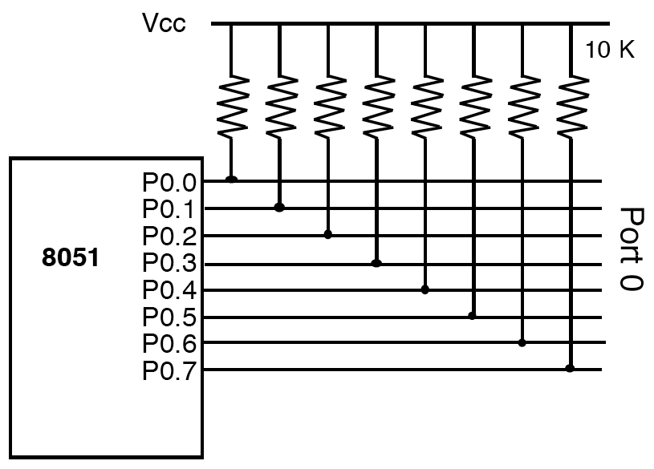
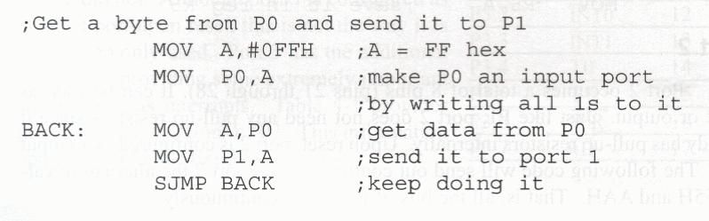
PORT 0
The Port 1 is a general purpose input/output port which can be used for a variety of interfacing tasks.
To use the pins of port 0 as both input and output each pin must be connected externally to a 10KΩ pull-up resistor.

Slide 14
Port 0 is 8 open drain bi-directional IO port, Open drain simply means a transistor that connects to Gnd.
Bi-directional means this PORT may be configured as input or output.
P0 register is used for accessing PORT0. This register is bit accessible.
P0 doesn’t contain built-in pull-up resistor.
When any pin of this port is configured as an output, it acts as an “open drain”. If logic 0 is given to port bit, the pin will be connected to ground (0V). If logic 1 is given to port bit, the external output will keep on “floating”. So, to apply logic 1 (5V) on this output pin, it is necessary to connect an external pull-up resistor

Slide 15
Dual role of P0
Accessing 64K bytes of external memory, it needs a path for the 16 bits of the address Port 0 and 2 together can be used to address the external memory.
Port 0 can also be used to exchange data from the external port.
When the external memory is used with microcontroller, then the lower address byte (addresses A0-A7) is applied on P0. If not using external memory, all bits of P0 are configured for I/O purposes.
Writing 1 to some bit of P0 register will configure corresponding pin as input while writing 0 will configure that as output. By default, every pin is configured as input on power up..
P0 gives lower Byte of Address.

Slide 16
Port 1
It is an I/O port with no alternative functions and configured only as general I/O purposes.
This port does not need any pull-up resistors since it already has pull-up resistors internally.
If port 1 is configured as an output port, to make it an input port again, it must programmed as such by writing 1 to all its bits.
Upon reset, port 1 is configured as an input port.
In the following code, port 1 is configured first as an input port by writing 1 s to it, then data is received from that port and saved in R7, R6, and R5.

Slide 17
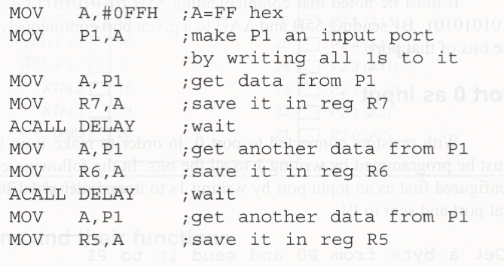
Port 1

Slide 18
Port 2
It can be used as input or output.
Has Internal pull-up resistor.
It is an I/O port with alternative functions
When the external memory is used with microcontroller, then the higher address byte (addresses A8-A15) is applied on P2.
When no external memory is used, all bits of P0 are configured as I/O purposes.
Upon reset, port 2 is configured as an input port.

Slide 19
Simple program to configure port 1 as a input and port 2 as output
void main()
{
P1=0xFF;
P2=0x00;
while(1)
{
P2=P1;
}
}

Slide 20
PORT 3 of 8051
P3 includes pins (10-17). On Reset, acts as an input port.
It is an I/O port with different function.
In hardware terms, this port is similar to P0 but it contains built-in pull-up resistor.
For input: Pin is configured as 1 for input.
For output: Pin is configured as 0 for output.
For using the alternative functions, a logic one (1) must be applied to appropriate bit of the P3 register.

Slide 21
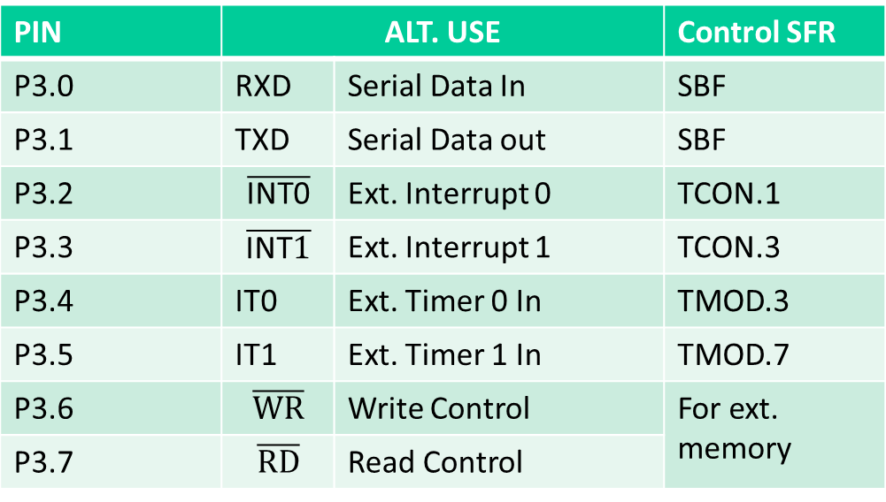
Port 3
Alternate use
providing some extremely important signals such as interrupts, serial I/O, timer/counter and read/write control for external memory.
PIN | ALT. USE |  | Control SFR
P3.0 | RXD | Serial Data In | SBF
P3.1 | TXD | Serial Data out | SBF
P3.2 |  | Ext. Interrupt 0 | TCON.1
P3.3 |  | Ext. Interrupt 1 | TCON.3
P3.4 | IT0 | Ext. Timer 0 In | TMOD.3
P3.5 | IT1 | Ext. Timer 1 In | TMOD.7
P3.6 |  | Write Control | For ext. memory
P3.7 |  | Read Control

Slide 22
I/O PROGRAMMING Byte Size I/O
LEDs are connected to bits P1 and P2. Write an 8051 C program that shows the count from 0 to FFH (0000 0000 to 1111 1111 in binary) on the LEDs.
Solution:
#include <reg51.h>
#define LED P2;
void main(void)
{
P1=00; //clear P1
LED=0; //clear P2
for (;;) //repeat forever
{
P1++; //increment P1
LED++; //increment P2
}
}
Ports P0 – P3 are byte-accessible and we use the P0 – P3 labels as
defined in the 8051/52 header file.

Slide 23
I/O PROGRAMMING Bit-addressable I/O
Write an 8051 C program to toggle only bit P2.4 continuously without disturbing the rest of the bits of P2.
Solution:
//Toggling an individual bit
#include <reg51.h>
sbit mybit=P2^4;
void main(void)
{
while (1)
{
mybit=1; //turn on P2.4
mybit=0; //turn off P2.4
}
}
Ports P0 – P3 are bit-
addressable and we use
sbit data type to access
a single bit of P0 - P3
Use the Px^y format, where
x is the port 0, 1, 2, or 3 and
y is the bit 0 – 7 of that port

Slide 24
I/O PROGRAMMING Bit-addressable I/O (cont’)
A door sensor is connected to the P1.1 pin, and a buzzer is connected to P1.7. Write an 8051 C program to monitor the door sensor, and when it opens, sound the buzzer. You can sound the buzzer by sending a square wave of a few hundred Hz.
#include <reg51.h>
void MSDelay(unsigned int);
sbit Dsensor = P1^1;
sbit Buzzer = P1^7;
void main(void)
{ Dsensor=1; //make P1.1 an input
while (1)
{ while (Dsensor==1) //while it opens
{ Buzzer=0;
MSDelay(200);
Buzzer=1;
MSDelay(200);
}
}
}

Slide 25
I/O PROGRAMMING Accessing SFR Addresses 80 - FFH
Write an 8051 C program to toggle all the bits of P0, P1, and P2 continuously with a 250 ms delay. Use the sfr keyword to declare the
port addresses.
sfr P0=0x80; sfr P1=0x90; sfr P2=0xA0;
void MSDelay(unsigned int);
void main(void)
{ while (1)
{ P0=0x55; //Accessing Ports as SFRs using sfr data type
P1=0x55;
P2=0x55;
MSDelay(250);
P0=0xAA;
P1=0xAA;
P2=0xAA;
MSDelay(250);
} }
Another way to access the SFR RAM space 80 – FFH is to use the sfr data type

Slide 26
I/O PROGRAMMING Using bit Data Type for Bit-addressable RAM
Write an 8051 C program to get the status of bit P1.0, save it, and
send it to P2.7 continuously.
#include <reg51.h>
sbit inbit = P1^0;
sbit outbit = P2^7;
bit membit; //use bit to declare bit- addressable memory
void main(void)
{
while (1)
{
membit=inbit; //get a bit from P1.0
outbit=membit; //send it to P2.7
}
}

Slide 27
IO PROGRAMMING PORT 0
The following code will continuously send out to port 0 the alternating value 55H and AAH
BACK: MOV A,#55H
MOV P0,A
ACALL DELAY
MOV A,#0AAH
MOV P0,A
ACALL DELAY
SJMP BACK
In order to make port 0 an input, the port must be programmed by writing 1 to all the bits
Port 0 is configured first as an input port by writing 1s to it, and then data is received from that port and sent to P1
MOV A,#0FFH ;A=FF hex
MOV P0,A ;make P0 an i/p port
;by writing it all 1s
BACK: MOV A,P0 ;get data from P0
MOV P1,A ;send it to port 1
SJMP BACK ;keep doing it
Port 0 is also designated as AD0-AD7,allowing it to be used for both address and data

Slide 28
IO PROGRAMMING PORT 1
Port 1 can be used as input or output
In contrast to port 0, this port does not need any pull-up resistors since it already has pull-up resistors internally
Upon reset, port 1 is configured as an input port
The following code will continuously send out to port 0 the alternating value 55H and AAH
MOV A,#55H
BACK: MOV P1,A
ACALL DELAY
CPL A
SJMP BACK

Slide 29
IO PROGRAMMING PORT 1 as INPUT
To make port 1 an input port, it must be programmed as such by writing 1
to all its bits
Port 1 is configured first as an input port by writing 1s to it, then data is received from that port and saved in R7 and R5
MOV A,#0FFH ;A=FF hex
MOV P1,A ;make P1 an input port by writing it all 1s
MOV A,P1 ;get data from P1
MOV R7,A ;save it to in reg R7
ACALL DELAY ;wait
MOV A,P1 ;another data from P1
MOV R5,A ;save it to in reg R5

Slide 30
IO PROGRAMMING PORT 2 and 3
Port 2 can be used as input or output
Just like P1, port 2 does not need any pull-up resistors since it already has pull-up resistors internally
Upon reset, port 2 is configured as an input port
In many 8051-based system, P2 is used as simple I/O
Port 3 can be used as input or output
Port 3 does not need any pull-up resistors
Port 3 is configured as an input port upon reset, this is not the way it is most commonly used

Slide 31
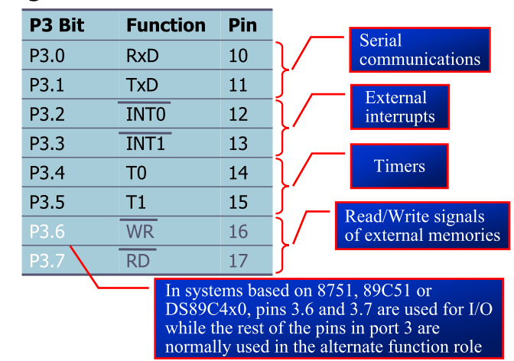
IO PROGRAMMING PORT3
Port 3 has the additional function of providing some extremely important signals

Slide 32
IO PROGRAMMING – Different ways of Accessing Entire 8 Bits
The entire 8 bits of Port 1 are accessed
BACK: MOV A,#55H
MOV P1,A
ACALL DELAY
MOV A,#0AAH
MOV P1,A
ACALL DELAY
SJMP BACK
Rewrite the code in a more efficient manner by accessing the port directly without going through the accumulator
BACK: MOV P1,#55H
ACALL DELAY
MOV P1,#0AAH
ACALL DELAY
SJMP BACK
Another way of doing the same thing
MOV A,#55H
BACK: MOV P1,A
ACALL DELAY
CPL A
SJMP BACK

Slide 33
I/O BIT MANIPULATION PROGRAMMING I/O Ports and Bit Addressability
Sometimes we need to access only 1 or 2 bits of the port
BACK: CPL P1.2 ;complement P1.2
ACALL DELAY
SJMP BACK
;another variation of the above program
AGAIN: SETB P1.2 ;set only P1.2
ACALL DELAY
CLR P1.2 ;clear only P1.2
ACALL DELAY
SJMP AGAIN

Slide 34
8051 Embedded programming in C

Slide 35
WHY PROGRAM 8051 IN C
Compilers produce hex files that is embedded to ROM of microcontroller
The size of hex file is the main concern
Microcontrollers have limited on-chip ROM
Code space for 8051 is limited to 64K bytes
C programming is less time consuming, but has larger hex file size
The reasons for writing programs in C
It is easier and less time consuming to write in C than Assembly
C is easier to modify and update
You can use code available in function libraries
C code is portable to other microcontroller with little of no modification

Slide 36
DATA TYPES
A good understanding of C data types for 8051 can help programmers to create smaller hex files
Unsigned char
Signed char
Unsigned int
Signed int
Sbit (single bit)
Bit and sfr

Slide 37
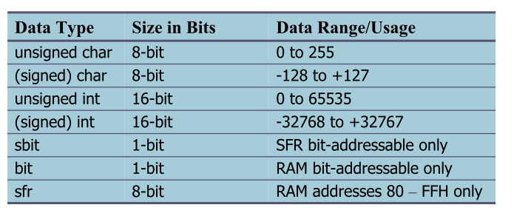
DATA TYPES Bit and sfr
The bit data type allows access to single bits of bit-addressable memory spaces 20 – 2FH
 To access the byte-size SFR registers, we use the sfr data type

Slide 38
DATA TYPES Unsigned char
 The character data type is the most natural choice
8051 is an 8-bit microcontroller
 Unsigned char is an 8-bit data type in the range of 0 – 255 (00 – FFH)
One of the most widely used data types for the 8051
Counter value
ASCII characters
C compilers use the signed char as the default if we do not put the keyword unsigned

Slide 39
DATA TYPES Unsigned char(cont’)
Write an 8051 C program to send values 00 – FF to port P1.
#include <reg51.h>
void main(void)
{ unsigned char z;
for (z=0;z<=255;z++)
P1=z; }
Write an 8051 C program to send hex values for ASCII characters of 0, 1, 2, 3, 4, 5, A, B, C, and D to port P1.
#include <reg51.h>
void main(void)
{ unsigned char mynum[]=“012345ABCD”;
unsigned char z;
for (z=0;z<=10;z++)
P1=mynum[z]; }
Pay careful attention to the size of the data
2. Try to use unsigned char instead of int if possible

Slide 40
DATA TYPES Unsigned char(cont’)
Write an 8051 C program to toggle all the bits of P1 continuously.
Solution:
//Toggle P1 forever
#include <reg51.h>
void main(void)
{
for (;;)
{ P1=0x55;
P1=0xAA; }
}

Slide 41
DATA TYPES Signed char
The signed char is an 8-bit data type
Use the MSB D7 to represent – or + values from –128 to +127
 We should stick with the unsigned char unless the data needs to be represented as signed numbers (e.g… temperature)
Write an 8051 C program to send values of –4 to +4 to port P1. //Signed numbers
#include <reg51.h>
void main(void)
{ char mynum[ ]={+1,-1,+2,-2,+3,-3,+4,-4};
unsigned char z;
for (z=0;z<=8;z++)
P1=mynum[z]; }

Slide 42
DATA TYPES (Unsigned and Signed int)
The unsigned int is a 16-bit data type
Takes a value in the range of 0 to 65535 (0000 – FFFFH)
Define 16-bit variables such as memory addresses
Set counter values of more than 256
Since registers and memory accesses are in 8-bit chunks, the misuse of int variables will result in a larger hex file
Signed int is a 16-bit data type
Use the MSB D15 to represent – or +
We have 15 bits for the magnitude of the number from –32768 to +32767

Slide 43
DATA TYPES Single Bit(cont’)
Write an 8051 C program to toggle bit D0 of the port P1 (P1.0) 50,000 times.
#include <reg51.h>
sbit MYBIT=P1^0;
void main(void)
{
unsigned int z;
for (z=0;z<=50000;z++)
{
MYBIT=0;
MYBIT=1;
}
}
sbit keyword allows access to the single bits of the SFR registers

Slide 44
DATA TYPES Bit and sfr
The bit data type allows access to single bits of bit-addressable memory spaces 20 – 2FH
 To access the byte-size SFR registers, we use the sfr data type

Slide 45
I/O PROGRAMMING Byte Size I/O
LEDs are connected to bits P1 and P2. Write an 8051 C program that shows the count from 00 to FF (0000 0000 to 1111 1111 in binary) on the LEDs.
Ports P0 – P3 are byte-accessible and we use the P0 – P3 labels as defined in the 8051/52 header file.
#include <reg51.h>
#define LED P2;
void main(void)
{
P1=00; //clear P1
LED=0; //clear P2
for (;;) //repeat forever
{
P1++; //increment P1
LED++; //increment P2
}
}

Slide 46
I/O PROGRAMMING Byte Size I/O
#include <reg51.h>
void MSDelay(unsigned int);
void main(void)
{
unsigned char mybyte;
P1=0xFF; //make P1 input port
while (1)
{
mybyte=P1; //get a byte from P1
MSDelay(500);
P2=mybyte; //send it to P2
}
}
Write an 8051 C program to get a byte of data form P1, wait 1/2 second, and then send it to P2.

Slide 47
I/O PROGRAMMING Byte Size I/O
#include <reg51.h>
void main(void)
{
unsigned char mybyte;
P0=0xFF; //make P0 input port
while (1)
{
mybyte=P0; //get a byte from P0
if (mybyte<100)
P1=mybyte; //send it to P1
else
P2=mybyte; //send it to P2
}
}
Write an 8051 C program to get a byte of data form P0. If it is less than 100, send it to P1; otherwise, send it to P2.

Slide 48
I/O PROGRAMMING Bit addressable I/O
Toggling an individual bit
#include <reg51.h>
sbit mybit=P2^4;
void main(void)
{
while (1)
{
mybit=1; //turn on P2.4
mybit=0; //turn off P2.4
}
}
Write an 8051 C program to toggle only bit P2.4 continuously without
disturbing the rest of the bits of P2.
Ports P0 – P3 are bit-
addressable and we use
sbit data type to access
a single bit of P0 - P3

Slide 49
I/O PROGRAMMING Bit addressable I/O
#include <reg51.h>
sbit mybit=P1^5;
void main(void)
{
mybit=1; //make mybit an input
while (1)
{
if (mybit==1)
P0=0x55;
else
P2=0xAA;
}
}
Write an 8051 C program to monitor bit P1.5. If it is high, send 55H to P0; otherwise, send AAH to P2.

Slide 50
I/O PROGRAMMING Bit addressable I/O
A door sensor is connected to the P1.1 pin, and a buzzer is connected to P1.7. Write an 8051 C program to monitor the door sensor, and when it opens, sound the buzzer.
You can sound the buzzer by sending a square wave of a few hundred Hz.
#include <reg51.h>
void MSDelay(unsigned int);
sbit Dsensor=P1^1;
sbit Buzzer=P1^7;
void main(void)
{ Dsensor=1; //make P1.1 an input
while (1)
{
while (Dsensor==1) //while it opens
{
Buzzer=0;
MSDelay(200);
Buzzer=1;
MSDelay(200);
} } }

Slide 51
I/O PROGRAMMING Accessing SFR Addr 80 - FFH
Write an 8051 C program to toggle all the bits of P0, P1, and P2 continuously with a 250 ms delay.
Use the sfr keyword to declare the
port addresses.
Another way to access the SFR RAM space 80 – FFH is to use the sfr data type
//Accessing Ports as SFRs using sfr data type
sfr P0=0x80; sfr P1=0x90; sfr P2=0xA0;
void MSDelay(unsigned int);
void main(void)
{
while (1)
{
P0=0x55; P1=0x55; P2=0x55;
MSDelay(250);
P0=0xAA; P1=0xAA; P2=0xAA;
MSDelay(250);
}
}

Slide 52
I/O PROGRAMMING Accessing SFR Addr 80 - FFH
Write an 8051 C program to turn bit P1.5 on and off 50,000 times.
We can access a single bit of any SFR if we specify the bit address
Notice that there is no #include <reg51.h>.
This allows us to access any byte of the SFR RAM
space 80 – FFH. This is widely used for the new
generation of 8051 microcontrollers.
sbit MYBIT=0x95;
void main(void)
{
unsigned int z;
for (z=0;z<50000;z++)
{
MYBIT=1;
MYBIT=0;
}
}

Slide 53
I/O PROGRAMMING Using bit Data Type for Bit-addressable RAM
#include <reg51.h>
sbit inbit=P1^0;
sbit outbit=P2^7;
bit membit; //use bit to declare bit- addressable memory
void main(void)
{
while (1)
{
membit=inbit; //get a bit from P1.0
outbit=membit; //send it to P2.7
}
}
Write an 8051 C program to get the status of bit P1.0, save it, and send it to P2.7 continuously.

Slide 54
Example
LED blinking with input output ports 8051 microcontroller
Input to the microcontroller can be given through push button and output can be seen through LED.
First all the port pins are defined.
Port 2 is used as output port and port 3 is used as input port.
These Ports are initialized with 0 (to write) and 1 (to read) logic respectively.
Delay function is used to give the delay in showing output.
Frequency of crystal should be set to 11.059MHz.

Slide 55
WORKING of input output ports 8051 microcontroller
When we run the simulation, if first push button is pressed, first led will glow.
It will keep glowing for 1 second and then it goes off. When 2nd push button is pressed, 2nd led will glow.
Any LED can be ON according to the respective input of the button.
If we want to show the output for more time then delay call is passed large integer value.

